Slide 1
Application layer

Slide 2
DNS
DNS – Domain Name System
Purpose - To map a name(i.e. URL) onto an IP address

Slide 3
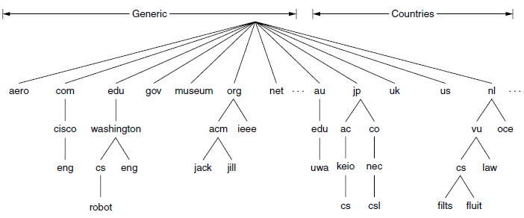
DNS Namespace
Internet is divided logically over 250 top-level domains, where each domain covers many hosts
Each domain is partitioned into subdomains, and these are further partitioned, and so on

Slide 4
Domain Resource Records
Every domain can have a set of resource records associated with it
DNS actually maps domain names onto resource records
Resource record is 5-tuple
Typical format
Domain_name Time_to_live Class Type Value

Slide 5
Domain Resource Records
Domain_name - domain to which this record applies
Time_to_live - an indication of how stable the record is. Information that is highly stable is assigned a large value in seconds.
Class - For Internet information, It is always IN
Type - what kind of record this is
Value - can be a number, a domain name,or an ASCII string. The semantics depend on the record type.

Slide 6
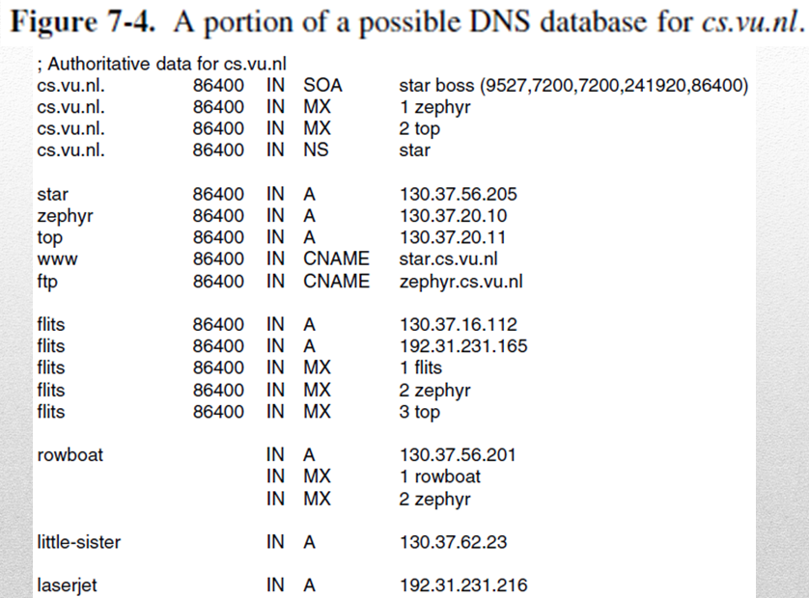
Domain Resource Records

